Slide 1




Efficient Decompositional Rule Extraction for Deep Neural Networks
XAI4Debugging Workshop @ NeurIPS 2021
Mateo Espinosa Zarlenga
me466@cam.ac.uk
Zohreh Shams
zs315@cam.ac.uk
Mateja Jamnik
mateja.jamnik@cl.cam.ac.uk

Slide 2


Introduction: Unboxing Deep Neural Networks
Deep Neural Networks (DNNs) are notoriously hard to debug and interpret
It is hard to conceptually understand how different weights and activations affect a given prediction
The high-dimensionality of a DNN’s latent space makes it difficult to extract semantically meaningful information from it

Slide 3
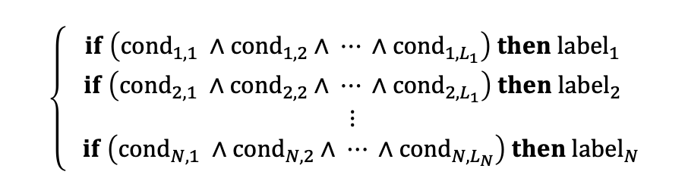
Introduction: DNN Rule Extraction
Possible solution: explain a DNN’s predictions using a rule-based model that approximates its decision boundary
Rule Extraction
Explain and debug
predictions
$$\left\{\begin{aligned}if \left({cond}_{1,1} ∧{cond}_{1, 2}∧ ⋯ ∧{cond}_{1, L_{1}}\right) then {label}_{1} \\ if \left({cond}_{2,1} ∧{cond}_{2, 2}∧ ⋯ ∧{cond}_{2, L_{1}}\right) then {label}_{2} \\ ⋮ \\ if \left({cond}_{N,1} ∧{cond}_{N,2}∧ ⋯ ∧{cond}_{N, L_{N}}\right) then{ label}_{N}\end{aligned}\right.$$
Global Interpretability

Slide 4
Introduction: DNN Rule Extraction
Nevertheless, current state-of-the-art decompositional rule extraction methods for DNNs suffer from two significant limitations:
They are intractable as the size of the DNN or the training set increases
They are extremely sensible to their training data (i.e., exhibit high variance)

Slide 5
Efficient CLAuse-wIse Rule Extraction (ECLAIRE)

Slide 6
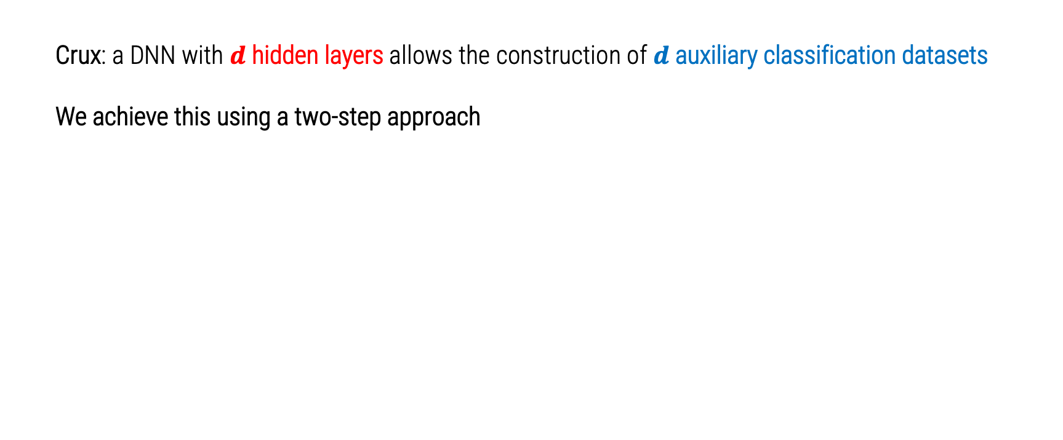
ECLAIRE: Algorithm Overview
Crux: a DNN with $d$ hidden layers allows the construction of $d$ auxiliary classification datasets
We achieve this using a two-step approach

Slide 7
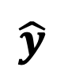
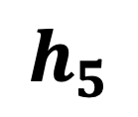
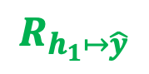

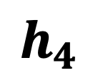
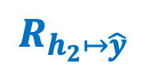
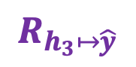
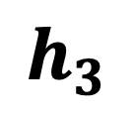
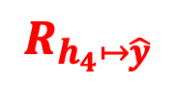
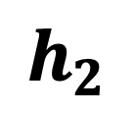
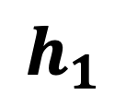

ECLAIRE: Algorithm Overview
Step 1: use decision trees to extract intermediate rule sets mapping hidden layers to predictions
$$x$$
$$R_{h_{2}↦\hat{y}}$$
$$h_{1}$$
$$h_{2}$$
$$h_{3}$$
$$h_{4}$$
$$R_{h_{3}↦\hat{y}}$$
$$R_{h_{4}↦\hat{y}}$$
$$h_{5}$$
$$\hat{y}$$
$$\text{argmax}$$
$$R_{h_{1}↦\hat{y}}$$

Slide 8


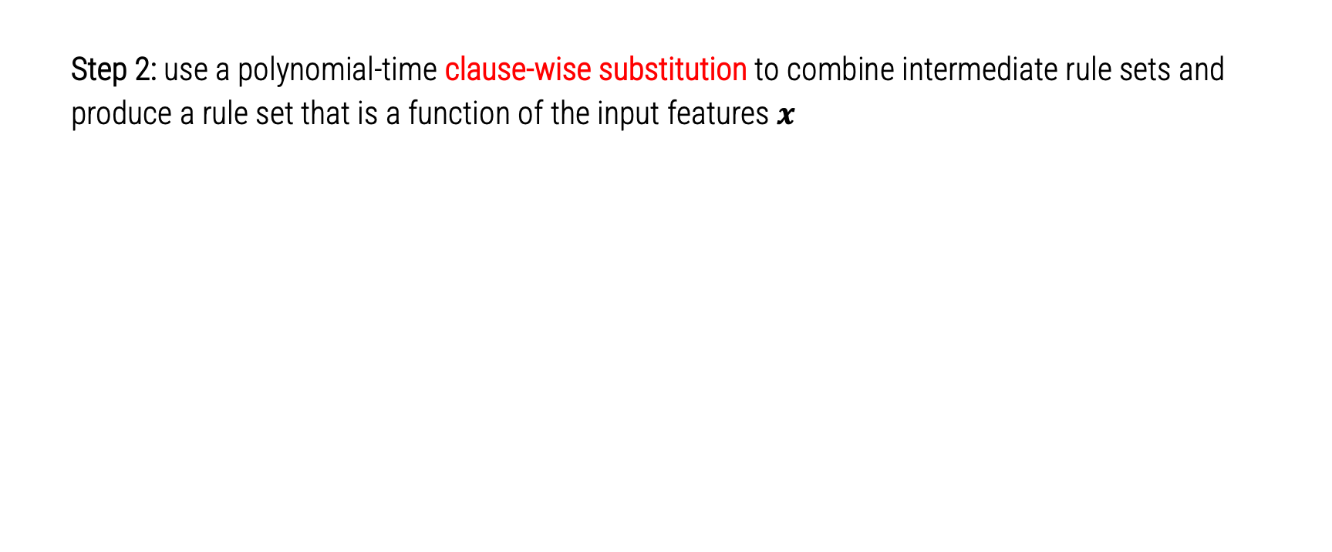
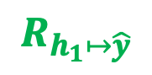

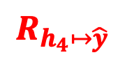

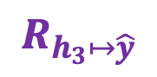

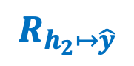
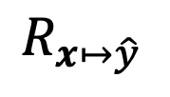
ECLAIRE: Algorithm Overview
Step 2: use a polynomial-time clause-wise substitution to combine intermediate rule sets and produce a rule set that is a function of the input features $x$
$$s{\text{ubstitute}}_{x}\left(R_{h_{1}↦\hat{y} }\right)$$
$$R_{h_{1}↦\hat{y}}$$
$$s{\text{ubstitute}}_{x}\left(R_{h_{2}↦\hat{y} }\right)$$
$$R_{h_{2}↦\hat{y}}$$
$$⋃$$
$$R_{x↦\hat{y} }$$
$$s{\text{ubstitute}}_{x}\left(R_{h_{3}↦\hat{y} }\right)$$
$$R_{h_{3}↦\hat{y}}$$
$$s{\text{ubstitute}}_{x}\left(R_{h_{4}↦\hat{y} }\right)$$
$$R_{h_{4}↦\hat{y}}$$

Slide 9
ECLAIRE: Algorithm Properties
This gives us a decompositional rule extraction algorithm that:
Has a polynomial-time worst-case runtime
Can be applied to any network topology
Can be easily parallelized

Slide 10
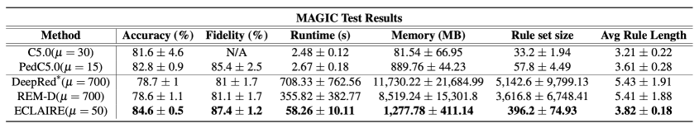
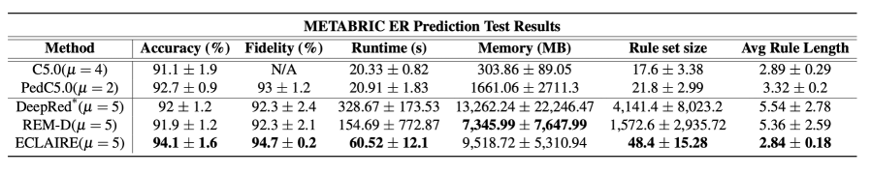
Evaluation
ECLAIRE can efficiently extract comprehensible and high-fidelity rulesets in both safety-critical tasks (breast cancer prognosis) and large models/training sets
For further results in a variety of tasks, please refer to our paper
Orders of magnitude less resources
More robust to different initializations/folds (i.e., less variance)
Higher fidelity and performing rulesets than SOTA
Significantly smaller rulesets

Slide 11
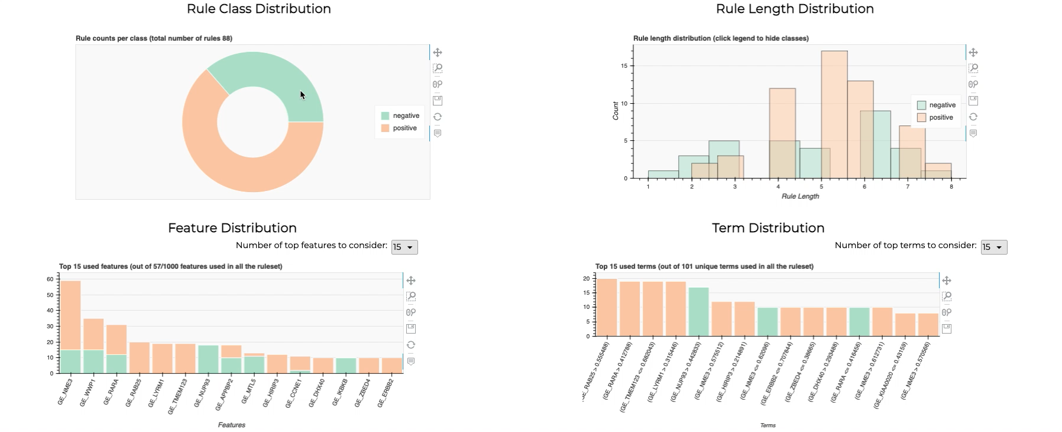
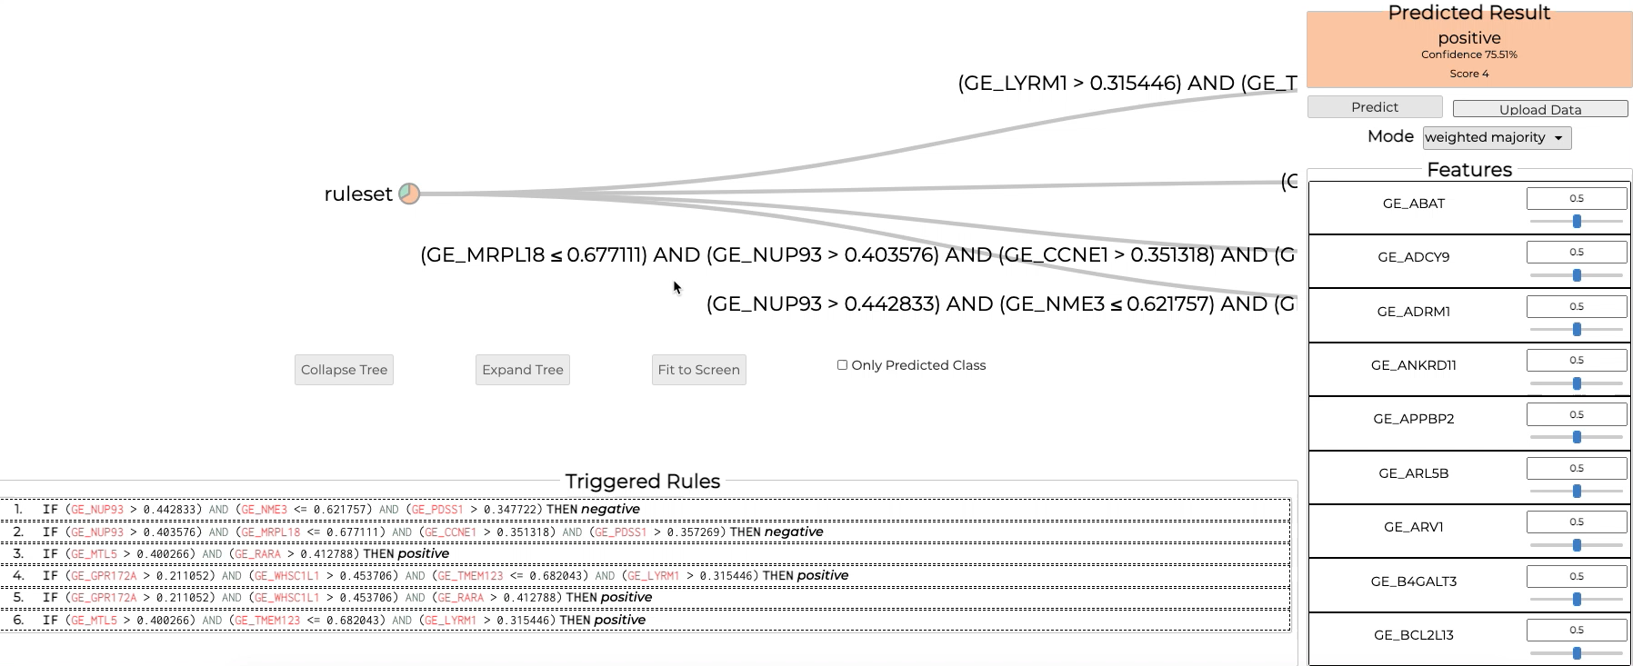
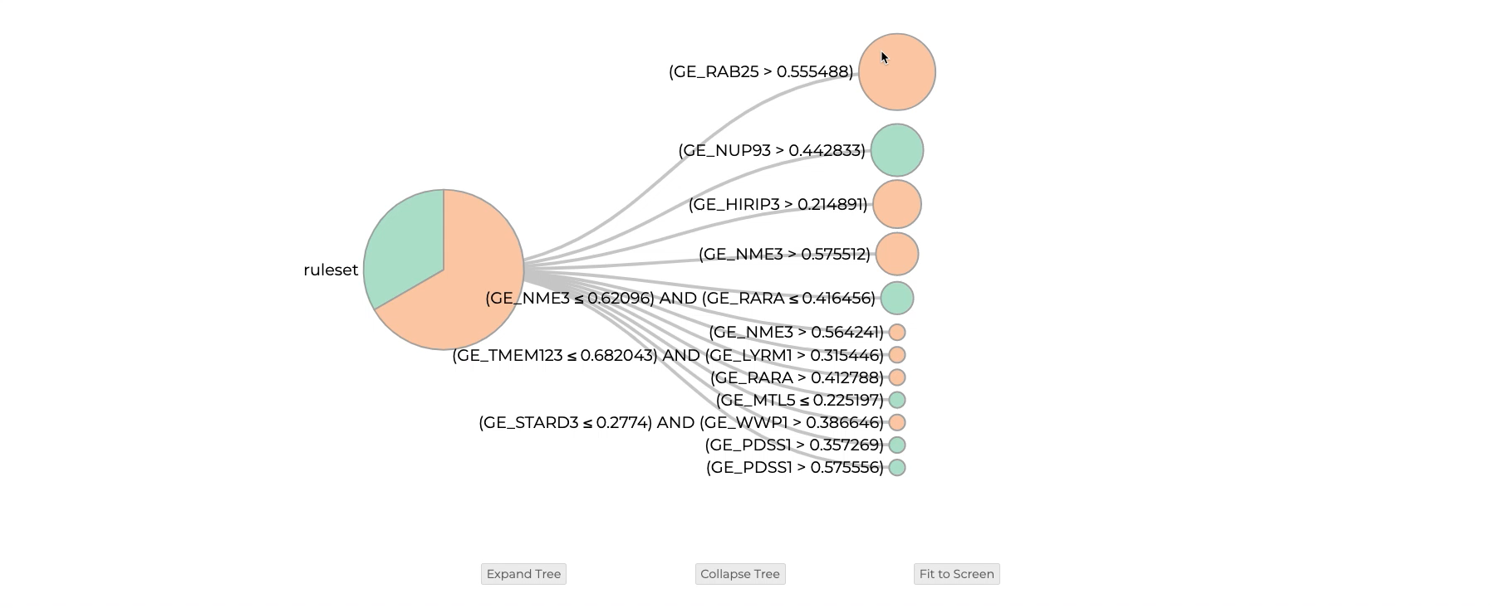
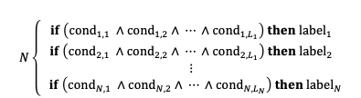
REMIX: Open-source Python Package
Analyze Ruleset
Predict & Explain
Efficient Rule Extraction
$$N\left\{\begin{aligned}if \left({cond}_{1,1} ∧{cond}_{1, 2}∧ ⋯ ∧{cond}_{1, L_{1}}\right) then {label}_{1} \\ if \left({cond}_{2,1} ∧{cond}_{2, 2}∧ ⋯ ∧{cond}_{2, L_{1}}\right) then {label}_{2} \\ ⋮ \\ if \left({cond}_{N,1} ∧{cond}_{N,2}∧ ⋯ ∧{cond}_{N, L_{N}}\right) then{ label}_{N}\end{aligned}\right.$$
Explore Rules
Paper, code, and visualization tools can be found at: https://github.com/mateoespinosa/remix
Please checkout our paper and poster presentation for further results and details

